Slide 1
Digital Portfolio
STUDENT NAME: Mohamed Affrarudeen.H
REGISTER NO AND NMID: 24134080500121032 / 9A64EDF5222BD88B4FD4336FFF6261EF
DEPARTMENT: BCA DEPARTMENT OF COMPUTER SCIENCE
COLLEGE: TBML COLLEGE/ANNAMALAI UNIVERSITY

Slide 2
PROJECT TITLE. Smart Digital Portfolio with Skill Recommendation and Recruiter Analytics
A digital portfolio is a collection of digital artifacts that showcase an individual's work, skills, and achievements.
It's often used by students, professionals, and creatives to demonstrate their expertise and accomplishments.A digital portfolio can include:- Projects and assignments

Slide 3


AGENDA
Problem Statement
Project Overview
End Users
Tools and Technologies
Portfolio design and Layout
Features and Functionality
Results and Screenshots
Conclusion
Github Link
3/21/2024 Annual Review

Slide 4

PROBLEM STATEMENT
Students often rely on static resumes which fail to demonstrate real-time skills and projects.
Recruiters struggle to assess candidates effectively.
There is no intelligent platform to recommend new skills and analyze recruiter engagement.
Problem: Lack of a smart and interactive student portfolio system.

Slide 5

PROJECT OVERVIEW
This project creates a smart web-based portfolio.
Provides an interactive, modern showcase of skills, projects, and achievements.
AI features help in skill recommendations and recruiter activity tracking.
Bridges the gap between students and recruiters.

Slide 6

WHO ARE THE END USERS?
Students: Showcase projects and achievements.
Recruiters: Quickly evaluate candidates with analytics.
Institutions: Assess student growth and digital competency.

Slide 7

TOOLS AND TECHNIQUES
Frontend: React.js, HTML5, CSS3, JavaScript
Backend: Python Django / Node.js
Database: MongoDB / MySQL
AI: Python libraries (scikit-learn, NLP models, OpenAI API)
Version Control: GitHub
Hosting: Netlify / Vercel / AWS

Slide 8
8
8
POTFOLIO DESIGN AND LAYOUT
Responsive Design → Works on mobile & desktop
Sections:
About Me / Home
Education & Skills (with AI-based suggestions)
Projects (auto-pulled from GitHub)
Certifications & Achievements
Recruiter Analytics Dashboard
Contact Form (Email + LinkedIn)
8

Slide 9
FEATURES AND FUNCTIONALITY
1.Responsive and interactive design
2.Skill recommendation (AI)
3.GitHub integration for real-time project updates
4.Recruiter analytics dashboard (profile visits, clicks)
5.Smart Resume generator (PDF download)
6.Dark/Light mode toggle

Slide 10

RESULTS AND SCREENSHOTS
Home page
Skills dashboard
Projects showcase
Recruiter analytics page
3/21/2024 Annual Review
10

Slide 11
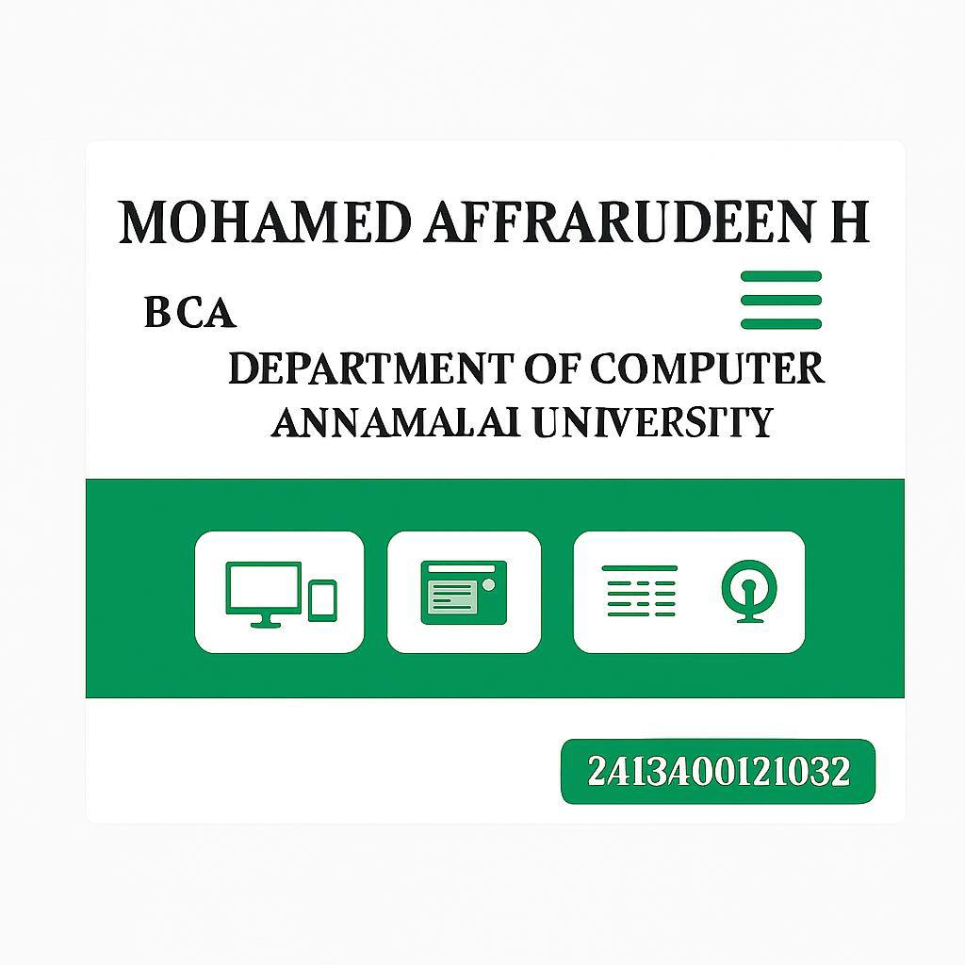
Screenshot shot

Slide 12
LINK FOR REFERENCE
https://github.com/afrar0820-cmd/Mohamed-Affrarudeen-TNSDC-FWD-DP.git

Slide 13
CONCLUSION
Developed a smart portfolio for students.
Provides better visibility for career growth.
Helps recruiters evaluate more effectively.
Future scope: AI interview Q&A chatbot, LinkedIn auto-sync, career roadmap generator.
13

